Slide 1
Chapter 2: Bits and Bytes
Topics
Why bits?
Binary Logic
Representing information as bits
Binary/Hexadecimal
Byte representations
ints, floats, double precision

Slide 2
Announcements
Data Lab is due Friday Sept 13 by 11:55 pm
Bit manipulation operations – Chapter 2
Voluntary C assessment quiz
If you score <=70%, then review C using tutorial links
Chap 2 Data Quiz will be released soon, due in about a week
Addition, subtraction, signed, overflow
Read Chapter 2.1-2.3 and do practice problems

Slide 3
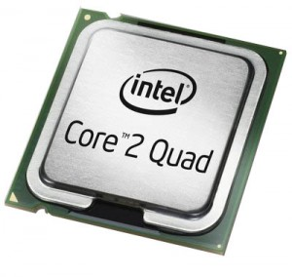
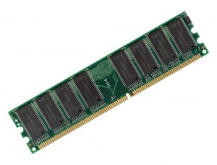
Recap: Systems In a Nutshell
add a,b
sub a,b
move a…
Lines of
Source
code
Pre-processor
&
Compiler
Lines of
Assembly
code
Assembler
&
Linker
Chapter 2
10101010
00001010
10101010
01010111
Lines of
Binary
code &
data
Memory
11101110
00111011
10000111

Slide 4
Decimal Representation
Decimal representation (Base 10) is what we humans naturally gravitate to, given 10 digits (fingers)!
7126 base 10 = 7126₁₀
= 7000 + 100 + 20 + 6
= 7*10³ + 1*10² + 2*10¹ + 6*10⁰
By convention, we write the most significant digit on the left, followed by the second most significant digit, then the 3rd most significant digit, etc., until we reach the least significant digit

Slide 5
Binary Representation – Why Bits?
0 1 0 1₂ = 0*2³ + 1*2² + 0*2¹ + 1*2⁰
= 0 + 4 + 0 + 1 = 5₁₀
Each binary digit is called a ‘bit’
Base 2 or Binary is easier to represent via electronic circuits than Base 10
Digital transistor circuits can easily represent a ‘0’ and a ‘1’
A ‘1’ = +5 volts, a ‘0’ = 0 volts, so only 2 voltage levels
Don’t have to implement 10 different voltage levels as in base 10
Easy to implement digital logic (AND, OR, etc.) with binary
Easy to implement Base 2 arithmetic on top of digital logic!
much of Base 10 arithmetic using Base 2 arithmetic (integers are exact, but floats are approximations)
Notes:
Most digital circuits today are based on CMOS (Complementary Metal Oxide Semiconductor) technology.
CMOS typically combines together NMOS and PMOS transistors to form digital logic and arithmetic circuits

Slide 6
Digital Logic via Boolean Algebra
Developed by George Boole in 19th Century
Algebraic representation of logic
Encode “True” as 1 and “False” as 0
And “&”: output Y = A & B
A&B = 1 only when both A=1 and B=1
B
A | B | &
0 | 0 | 0
1 | 0 | 0
0 | 1 | 0
1 | 1 | 1
A
Truth Tables
(two forms)
Notes:
Now we’re representing variables as TRUE/FALSE Booleans *and* performing *logical* operations on them. In the next subsections, we’ll consider representing variables as integers, and performing *arithmetic* operations on them. Note the above tables are called “truth tables”.

Slide 7
Common Digital Logic Operations
And “&”
A&B = 1 only when both A=1 and B=1
Or “|”
A|B = 1 when either A=1 or B=1
B
A
Not “~”
~A = 1 only when A=0
Exclusive-Or (Xor) “^”
A^B = 1 when either A=1 or B=1, but not both
Other operators: NAND (Not AND), NOR (Not OR), etc.
Notes:
Now we’re representing variables as TRUE/FALSE Booleans *and* performing *logical* operations on them. In the next subsections, we’ll consider representing variables as integers, and performing *arithmetic* operations on them. Note the above tables are called “truth tables”.

Slide 8
Implementing Digital Logic using Transistors
D
Silicon transistor (NMOS)
Three terminals. Input is the Gate G
Acts like a simple ON/OFF switch
Current flows from high voltage to low voltage
G
S
D
When a high voltage is applied to the input Gate G, then this connects the two terminals D and S, i.e. closes the switch, and current flows between them
G = High
voltage
Current
can flow
S
When a low voltage is applied to Gate, then the two terminals are disconnected, i.e. opens the switch, and no current flows
D
G = Low
voltage
No
Current
flows
S
Notes:
This is an example of an n-type Metal Oxide Semiconductor (MOS) Field Effect Transistor (FET), or NMOS for short. See MOSFET for more.

Slide 9
Implementing an Inverter or Not “~” Operation
High input connects Output to Ground
Low input means no current flows, so output stay high
An Inverter circuit
Power = +3 or +5 Volts
Power
Power
resistor
R
resistor
R
Voltage drop when current flows
resistor
R
Output
Output
= Low
Output
= High
Input
Input = High
Input = Low
Ground
= 0 Volts
Ground
Ground
Thus we have an inverter or Not “~” operator:
Input ‘1’ (High voltage) => output ‘0’ (Low voltage)
Input ‘0’ (Low voltage) => output ‘1’ (High voltage)
Notes:
See Wikipedia for more.

Slide 10
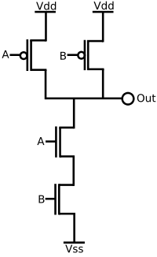
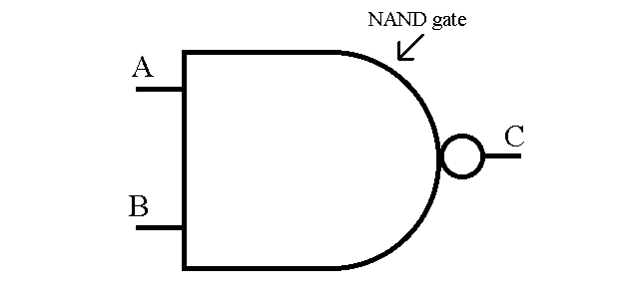
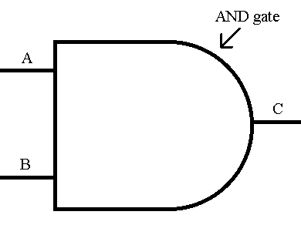
Implementing a NAND operation
Power
NAND = Negative AND
Output = ~(A AND B)
Symbol for a NAND gate is:
Pmos transistor
has opposite
behavior of nmos
How do I make an AND gate?
Concatenate an inverter after a NAND gate!
AND gate symbol:
B
NAND
A
Ground
Notes:
Top two transistors are pmos, while the bottom two transistors are nmos. Pmos has the opposite behavior of nmos, namely when the input to a pmos transistor is HIGH, then two terminals are disconnected, while when the input is LOW, the two terminals are connected. Mixing nmos and pmos transistors creates Complementary MOS (CMOS) digital logic circuits.

Slide 11
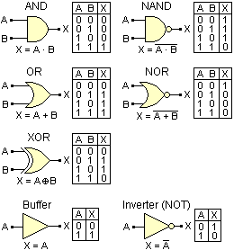
Binary Digital Logic Symbols
Notes:
See Wikipedia for more.

Slide 12
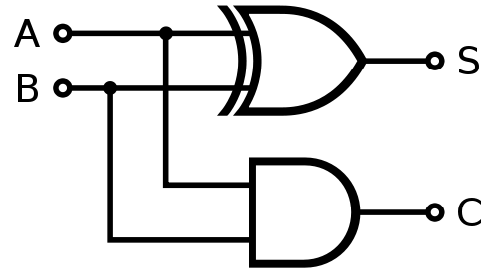
Building a Binary Adder
Bit A | Bit B | Sum S
0 | 0 | 0
0 | 1 | 1
1 | 0 | 1
1 | 1 | 0
One-bit Half Adder circuit
Sum bit S = A XOR B
Carry bit C = A AND B
One-bit Full Adder circuit extends Half Adder to also account for a bit carried in, not just the bit carried out
Example: an 8-bit Full Adder can be built by concatenating 8 one-bit Full Adders
Bit A | Bit B | Sum S | Carry C
0 | 0 | 0 | 0
0 | 1 | 1 | 0
1 | 0 | 1 | 0
1 | 1 | 0 | 1
One-bit Half Adder Circuit
Notes:
See Wikipedia for more.

Slide 13
Binary Representation (2)
Base 2 vs. Decimal conversion example:
89 base 10 = 89₁₀ = what in base 2 or binary?
Find the largest power of 2 that is <= # and then subtract.
Keep iterating until #=0.
89₁₀ = 64 + 16 + 8 + 1
= 2⁶ + 2⁴ + 2³ + 2⁰
= 0*2⁷ + 1*2⁶ + 0*2⁵ + 1*2⁴ + 1*2³ + 0*2² + 0*2¹ + 1*2⁰
= 0 1 0 1 1 0 0 1 ₂
Notes:
Other conversion methods: count how many times you can divide the number by 2 until the result is less than one, let count = count – 1, then remember this bit as 1*2^count. Let number = number – 1*2^count. Reset count = 0. Repeat until number is <=1.

Slide 14
Hexadecimal Representation
Hexadecimal (base 16) is more convenient (it’s power of 2) and compact notation for larger binary #’s
Consider a 32-bit number:
10101110001100101000101000011001₂
This is hard to read. So form 4-bit groups.
= 1010 1110 0011 0010 1000 1010 0001 1001₂
We then use hexadecimal notation:
Use characters ‘0’ to ‘9’ and ‘A’ to ‘F’
= A E 3 2 8 A 1 9 ₁₆
= 0xAE328A19
“0x” signifies hexadecimal or just hex. Note lower case 0xae328a19 is also valid.
Decimal
Hex
Binary
0
0
0000
0
0000
1
1
0001
1
0001
2
2
0010
2
0010
3
3
0011
3
0011
4
4
0100
4
0100
5
5
0101
5
0101
6
6
0110
6
0110
7
7
0111
7
0111
8
8
1000
8
1000
9
9
1001
9
1001
A
10
1010
10
1010
B
11
1011
11
1011
C
12
1100
12
1100
D
13
1101
13
1101
E
14
1110
14
1110
F
15
1111
15
1111
Notes:
64 bits is the standard word size in IA64 architectures.

Slide 15
How We Use These Representations
Since these are just numbers, we can use them to describe anything with numerical value
We’ll use them to describe the numerical values of data stored at various memory locations
Different data values, like real and integer values, positive and negative
We’ll also use them to describe the addresses of memory locations
Later, our code instructions will be encoded in binary as well

Slide 16
Byte-Addressed Memory
MEMORY
15₁₀
byte 15
14₁₀
byte 14
Byte = 8 bits
Binary 00000000₂ to 11111111₂
Decimal: 0₁₀ to 255₁₀
Hexadecimal 00₁₆ to FF₁₆
.
.
.
.
.
.
.
Memory addresses are referenced by their byte number
Example: a 16 byte memory
Memory address 15₁₀
= 16th byte (since memory starts at 0)
= binary address
00000000000000000000000000001111₂ in bytes
= hex address 0x0000000F in bytes
This memory stores how many bits?
Answer: 8*16 = 128 bits!
8 bits
3₁₀
2₁₀
byte 2
1₁₀
byte 1
0₁₀
byte 0
Memory Address
Notes:
What we’re trying to bring out here is that binary, hex and decimal can be used to describe both the data values/bytes stored *in* memory as well as the addresses *of* the memory.

Slide 17
Machine Words
Each CPU Has “Word Size”
Nominal size of integer-valued data
Including addresses
Early microprocessors were 8-bit CPUs. Today, many embedded microcontrollers are still 8-bit.
Intel evolved to 16-bit processors, and called these “words”.
addw and movw are assembly instructions where the “w” suffix stands for a 16-bit word and implies that 16-bit values are being added or moved
Most machines became 32 bits (4 bytes)
addl and movl are assembly instructions where the “l” suffix stands for a “long word” and implies that 32-bit values are being added or moved
Limits addresses to 4GB
Becoming too small for memory-intensive applications

Slide 18
Machine Words
Each CPU Has “Word Size”
Most newer systems are 64 bits (8 bytes)
Potentially address ≈ 1.8 X 10¹⁹ bytes or 18 Exabytes
addq and movq are assembly instructions where the “q” suffix stands for “quad word” (4*16=64) and implies that 64-bit values are being added or moved
Machines support multiple data formats
Fractions or multiples of word size
Always integral number of bytes

Slide 19
Word-Oriented Memory Organization
32-bit
Words
64-bit
Words
Memory
(bytes)
Addr.
0015
Addr
=
??
0014
Addresses Specify Byte Locations
Address of first byte in word
Addresses of successive words differ by 4 (32-bit) or 8 (64-bit)
0012
0013
Addr
=
??
0012
0008
0011
Addr
=
??
0010
0008
0009
0008
0007
Addr
=
??
0006
0004
0005
Addr
=
??
0004
0000
0003
Addr
=
??
0002
0000
0001
0000

Slide 20
Data Representations
Sizes of C Objects (in Bytes)
C Data Type Intel_x64 Typical 32-bit Intel IA32
int 4 4 4
long int 8 4 4
char 1 1 1
short 2 2 2
float 4 4 4
double 8 8 8
long double 10/16 8 10/12
char * 8 4 4
Or any other pointer
A float is a real # like -2.7143*10⁽⁻³⁾. A double just provides more precision than a float, something like 2.71433273882*10⁽⁻³⁾
A pointer stores an integer–like value that is interpreted as a memory location/address

Slide 21
Storing Data in Memory
Memory
(bytes)
Addr.
IA32 Example:
Address of int is 0x00000000
Address of float is 0x00000004
Address of character = ‘7’ is 0x00000009
Address of pointer is 0x0000000c
Note: the pointer points to another memory location, i.e. stores a memory location address
0015
value=
address
0014
pointer
4 bytes
0013
0012
char 1 byte
‘x’
0011
char 1 byte
‘y’
0010
char 1 byte
‘7’
0009
char 1 byte
‘!’
0008
0007
value
0006
e.g. if pointer = 0x00000004 it means the pointer is pointing to the float! (actually the first byte of the float)
float
4 bytes
0005
0004
0003
0002
int
4 bytes
value
0001
0000

Slide 22
Pointers in C
To declare a pointer to say an integer, here’s some code:
int x;
int *p = &x;
int * p declares the variable p to be a pointer to an integer
note how it differs from the declaration ‘int p’, which would just declare p to be an integer, not a pointer to an integer
&x means find the memory location/address of x
Thus, int *p = &x means initialize the value of the pointer p with the address of integer variable x.

Slide 23
Dereferencing Pointers in C
To find the value of a variable being pointed to, you must dereference a pointer. Here’s some code:
int x;
int *p = &x;
int y = *p;
p is a pointer to an integer. To get the value of the integer that p is pointing to, you use the dereference operator (*).
note how * is used first to declare a pointer, and is used later to dereference a pointer to find the value of the variable it is pointing to
Here, y = x.

Slide 24
Pointer Values
Since the pointer value is an address, then it doesn’t matter what type of variable is being pointed to, the size of the pointer value is always 4 bytes (IA32)
char c;
int x;
double d;
char *p1 = &c;
int *p2 = &x;
double *p3 = &d;
p1 is a pointer to a one-byte long char, but is 4 bytes long, because the address of the char is 4 bytes long.
p3 is a pointer to an 8-byte long double, but is 4 bytes long, because the address of the double (lowest byte) is 4 bytes long.

Slide 25
Relations Between Logic Operations
DeMorgan’s Laws
Express & in terms of |, and vice-versa
A & B = ~(~A | ~B)
A and B are true if and only if neither A nor B is false
A | B = ~(~A & ~B)
A or B are true if and only if A and B are not both false
Exclusive-Or using Inclusive Or
A ^ B = (~A & B) | (A & ~B)
Exactly one of A and B is true
This is Shannon’s circuit.
A ^ B = (A | B) & ~(A & B)
Either A is true, or B is true, but not both

Slide 26
General Boolean Algebras
Operate on Bit Vectors
Operations applied bitwise
All of the Properties of Boolean Algebra Apply
Note: &’ing two bit vectors together may be useful for the data lab
Example: determine the 3rd least-significant bit of an 8-bit quantity N
Define a mask = 00000100
Then compute N & mask, and right shift it by 3, i.e. perform
(N & mask) >> 3
01101001
& 01010101
01000001
01101001
| 01010101
01111101
01101001
^ 01010101
00111100
~ 01010101
10101010
01000001
01111101
00111100
10101010
Notes:
For logical operations, the bitwise AND, OR, XOR, etc. is self-contained independently within each bit column, i.e. there is no such thing as a carry from one column to the next.

Slide 27
Using Boolean Operators for Representing & Manipulating Sets
Representation
Width w bit vector represents subsets of {0, …, w–1}
a_{j} = 1 if j ∈ A
01101001 { 0, 3, 5, 6 }
76543210
01010101 { 0, 2, 4, 6 }
76543210
Operations
& Intersection 01000001 { 0, 6 }
| Union 01111101 { 0, 2, 3, 4, 5, 6 }
^ Symmetric difference 00111100 { 2, 3, 4, 5 }
~ Complement 10101010 { 1, 3, 5, 7 }

Slide 28
Bit-Level Operations in C
Operations &, |, ~, ^ Available in C
Apply to any “integral” data type
long, int, short, char
View arguments as bit vectors
Arguments applied bit-wise
Examples (Char data type)
~0x41 --> 0xBE
~01000001₂ --> 10111110₂
~0x00 --> 0xFF
~00000000₂ --> 11111111₂
0x69 & 0x55 --> 0x41
01101001₂ & 01010101₂ --> 01000001₂
0x69 | 0x55 --> 0x7D
01101001₂ | 01010101₂ --> 01111101₂

Slide 29
Supplementary Slides

Slide 30
Integer Algebra vs. Boolean Algebra
Integer Arithmetic
⟨Z, +, *, –, 0, 1⟩ forms a “ring”
Addition is “sum” operation
Multiplication is “product” operation
– is additive inverse
0 is identity for sum
1 is identity for product
Boolean Algebra
⟨{0,1}, |, &, ~, 0, 1⟩ forms a “Boolean algebra”
OR is “sum” operation
AND is “product” operation
~ is “complement” operation (not additive inverse)
0 is identity for sum
1 is identity for product

Slide 31
Boolean Algebra ≈ Integer Ring
Commutativity
A | B = B | A A + B = B + A
A & B = B & A A * B = B * A
Associativity
(A | B) | C = A | (B | C) (A + B) + C = A + (B + C)
(A & B) & C = A & (B & C) (A * B) * C = A * (B * C)
Product distributes over sum
A & (B | C) = (A & B) | (A & C) A * (B + C) = A * B + A * C
Sum and product identities
A | 0 = A A + 0 = A
A & 1 = A A * 1 = A
Zero is product annihilator
A & 0 = 0 A * 0 = 0
Cancellation of negation
~ (~ A) = A – (– A) = A

Slide 32
Boolean Algebra ≠ Integer Ring
Boolean: Sum distributes over product
A | (B & C) = (A | B) & (A | C) A + (B * C) ≠ (A + B) * (A + C)
Boolean: Idempotency
A | A = A A + A ≠ A
“A is true” or “A is true” = “A is true”
A & A = A A * A ≠ A
Boolean: Absorption
A | (A & B) = A A + (A * B) ≠ A
“A is true” or “A is true and B is true” = “A is true”
A & (A | B) = A A * (A + B) ≠ A
Boolean: Laws of Complements
A | ~A = 1 A + –A ≠ 1
“A is true” or “A is false”
Ring: Every element has additive inverse
A | ~A ≠ 0 A + –A = 0

Slide 33
Properties of & and ^
Boolean Ring
⟨{0,1}, ^, &, Ι, 0, 1⟩
Identical to integers mod 2
Ι is identity operation: Ι (A) = A
A ^ A = 0
Property Boolean Ring
Commutative sum A ^ B = B ^ A
Commutative product A & B = B & A
Associative sum (A ^ B) ^ C = A ^ (B ^ C)
Associative product (A & B) & C = A & (B & C)
Prod. over sum A & (B ^ C) = (A & B) ^ (A & C)
0 is sum identity A ^ 0 = A
1 is prod. identity A & 1 = A
0 is product annihilator A & 0 = 0
Additive inverse A ^ A = 0

Slide 34
Application of Boolean Algebra
Applied to Digital Systems by Claude Shannon
1937 MIT Master’s Thesis
Reason about networks of relay switches
Encode closed switch as 1, open switch as 0
A&~B
Connection when
A&~B | ~A&B
A
~B
~A
B
~A&B
= A^B

Slide 35
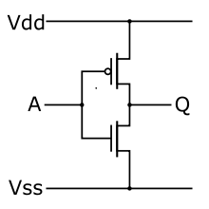
Binary Digital Logic Circuit Example
= +3 V
CMOS inverter circuit
Vdd = Power = +3 Volts, Vss = Ground = 0 Volts
Current flows from high voltage to low voltage
When input A = 0 V (Ground), then nmos transistor is shut off, while the pmos transistor is turned on, so Q is connected to Vdd = +3 V
pmos
= 0 V
~= +3 V
nmos
= 0 V
= +3 V
When input A = +3 V (Power), then pmos is off and nmos is on, so Q is connected to ground and is pulled down to 0 V
So Q is the opposite or inverse of A!
i.e. Q = ~A
AND, OR, NAND, NOR, ADD, SUBTRACT, etc. are also implemented this way…
pmos
= 3 V
~= 0 V
nmos
= 0 V
Notes:
See Wikipedia for more.

Slide 36
Byte-Oriented Memory Organization
Programs Refer to Virtual Addresses
Conceptually very large array of bytes
Actually implemented with hierarchy of different memory types
SRAM, DRAM, disk
Only allocate for regions actually used by program
Address space private to particular “process”
Program being executed
Program can clobber its own data, but not that of others
Compiler + Run-Time System Control Allocation
Where different program objects should be stored
Multiple mechanisms: static, stack, and heap
In any case, all allocation within single virtual address space

